Slide 1

HOME-American Rescue Plan Program (Home-arp)
  City of Anniston
  Community Development Department
  4309 McClellan Blvd
  Anniston, AL 36206

Slide 2
AGENDA
2021 ARP Act Overview
Qualifying Populations
Other Populations Definitions
Eligible Activities
Project Records
Record Retention
HOME-ARP Income & Rent Limits
Questions

Slide 3
Funds were appropriated under Title II of Cranston-Gonzalez National Affordable Housing Act of 1990 (NAHA) – HOME Program Statute
$5 billion for homelessness assistance and assistance to other vulnerable populations to:
2021 American Rescue Plan Act
provide capital investment for permanent rental housing
upgrade available stock of shelter to include non-congregate shelter
provide tenant-based rental assistance and supportive services

Slide 4

Suspended certain HOME statutory requirements for HOME-ARP
2021 American Rescue Plan Act
Match Requirement
Community Housing Development Organization (CHDO) Set-aside
Requirement
Maximum per unit subsidy limit (aka, 221(3) limit)
24-month commitment deadline

Slide 5

Home-arp
70% of all HOME-ARP units must serve households based only upon their status as qualifying households.
Up to 30% of HOME-ARP assisted units may be restricted to households that are low-income households at 50% AMI.

Slide 6
Home-arp Qualifying Populations
Primarily benefit individuals and families that meet the requirements for one or more “qualifying populations”.
  Homeless (McKinney Act definition at 24 CFR 91.5)
  At-risk of homelessness (McKinney Act definition at 24 CFR 91.5)
  Fleeing/Attempting to Flee Domestic Violence, Dating Violence, Sexual Assault, Stalking, or Human Trafficking
    • Definitions from VAWA regulation at 24 CFR 5.2003, except
    • Human trafficking definition from Trafficking Victims Protection Act of 2000
    Other Populations where assistance would:
    • Prevent the family’s homelessness; or
    • Serve those with the Greatest Risk of Housing Instability
    *Veterans and families including veteran member that meet one of preceding criteria

Slide 7
Other Populations Definitions
Other Families Requiring Services or Housing Assistance to Prevent Homelessness: Households (i.e., individuals and families)
  who have previously been qualified as “homeless”
  are currently housed due to temporary or emergency assistance, including financial assistance, services, temporary rental assistance or some type of other assistance to allow the household to be housed, and
  who need additional housing assistance or supportive services to avoid a return to homelessness

Slide 8
Other Populations Definitions
At Greatest Risk of Housing Instability means a household that has:
1) Annual income ≤ 30% of area median income and is experiencing severe cost burden (i.e., is paying more than 50% of monthly household income toward housing costs);
OR
2) Annual income ≤ 50% of AMI and meets one of the conditions in paragraph (iii) of “At risk of homelessness” definition at §91.5

Slide 9
Home-arp eligible activities

Slide 10
HOME-ARP TBRA can assist qualifying populations to pay the rent, security deposits, utility payments, and utility deposits.
May provide up to 100% of rent and utility costs.
HOME-ARP TBRA
Assistance is attached to qualifying household rather than the unit.
Household can take assistance to another unit that is rent reasonable and meets applicable property standards.
*Requires new rental assistance contract

Slide 11

Eligible costs include:
HOME-ARP TBRA
rental assistance
security deposit payments
utility payments, as part of rental assistance
utility deposit payments, as part of rental assistance or security deposit assistance

Slide 12
HOME-ARP TBRA - Parameters of Assistance
HOME-ARP TBRA Households must be Anniston Residents
Maximum term of assistance is 2 years
Maximum Subsidy Limits
Document Household’s Contribution to Rent
Rent Reasonableness (Comparison to rent for other comparable unassisted units)
Inspections to verify compliance with HQS and occupancy standards
Rental Assistance Contract (Tri-Party Contract, City of Anniston Subrecipient, Owner, & Qualifying Household)
Qualifying Household must have an executed lease and lease addendum
Lead-Based Paint Disclosures for units pre-1978

Slide 13

HOME-ARP SUPPORTIVE SERVICES
HOME-ARP funds may be used to provide a broad range of supportive services to qualifying individuals or families:
      As a standalone program, or
      In combination with other HOME-ARP activities
Individuals and families who meet a QP definition and are not already receiving these services through another program are eligible for HOME-ARP supportive services
If qualifying household is already receiving the same eligible supportive service or was approved to receive the same service through another program/provider, participant does not have a need for HOME-ARP services.

Slide 14
SUPPORTIVE SERVICES ELIGIBLE ACTIVITIES
Three categories of eligible supportive services under HOME-ARP:
  McKinney-Vento Supportive Services -- adapted from the services listed in section 401(29) of the McKinney-Vento Homeless Assistance Act
  HOME-ARP Homelessness Prevention Services -- adapted from eligible homelessness prevention services under Emergency Solutions Grant (ESG) regulations and are revised, supplemented, and streamlined.
  Housing Counseling -- as defined in Part 5, including requirement that counseling only be provided by HUD-certified housing counselors.

Slide 15
ELIGIBLE COSTS
MCKINNEY-VENTO SUPPORTIVE SERVICES AND HOMELESSNESS PREVENTION SERVICES
Costs of homelessness prevention services are only eligible to the extent that assistance is necessary to help program participants regain stability in current housing or new permanent housing.
Subrecipient must document eligible costs as Mckinney-Vento Supportive Services, Homelessness Prevention Services, or Housing Counseling.
All qualifying households are eligible to receive HOME-ARP supportive services.

Slide 16
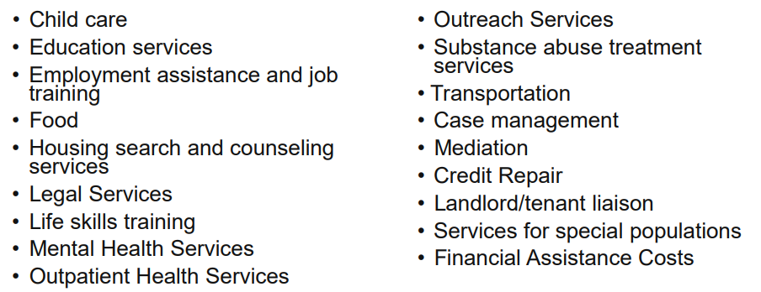
ELIGIBLE COSTS
MCKINNEY VENTO SUPPORTIVE SERVICES AND HOMELESSNESS PREVENTION SERVICES
Includes Rent or Utility for up-to 24 months over a 3-year period.

Slide 17
ELIGIBLE COSTS
HOUSING COUNSELING
Costs may only be paid under HOME-ARP if housing counseling services are provided by a HUD-certified housing counselors or organizations.
Costs for provision of services to existing homeowners related to homeownership and mortgages are NOT eligible under HOME-ARP.
If a qualifying household is a candidate for homeownership, costs associated with pre-purchase homebuying counseling, education, and outreach are eligible under HOME-ARP.
No Duplication of Services
Termination of Assistance: May terminate assistance to a qualifying households who violates program requirements or conditions of occupancy.

Slide 18
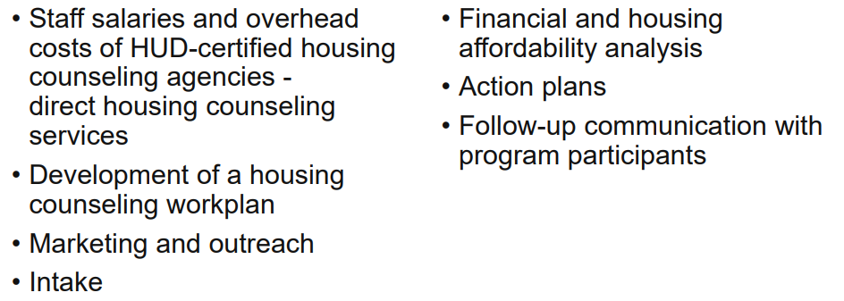
ELIGIBLE COSTS
HOUSING COUNSELING

Slide 19
HOME-ARP NON-CONGREGATE SHELTER
NCS is defined as one or more buildings that:
  Provide private units or rooms for temporary shelter
  Serve individuals and families that meet one or more of the qualifying populations
  Do not require occupants to sign a lease or occupancy agreement

Slide 20
HOME-ARP NON-CONGREGATE SHELTER
ELIGIBLE ACTIVITIES:
NCS activity may include the construction of new structures or the acquisition and/or rehabilitation of existing structures (such as motels, nursing homes, or other facilities) to be for use as HOME-ARP NCS.
  Acquisition of structures - New construction, with or without land acquisition
  Rehabilitation of existing structures (such as motels, nursing homes)
  Construct NCS Units

Slide 21
HOME-ARP NON-CONGREGATE SHELTER
ELIGIBLE COSTS:
Acquisition Costs: acquire improved or unimproved real property.
Demolition Costs: demolish existing structures.
Development Hard Costs: rehabilitate or construct HOME-ARP NCS units.
Rehabilitation - improvements to the project site, including installation of utilities or utility connections, laundry facilities, community facilities, on-site management, or supportive service offices.
Related Soft Costs: incurred by Subrecipient associated with financing, acquisition, and development of HOME-ARP NCS projects.
Replacement Reserve: Costs to capitalize a replacement reserve to cover reasonable and necessary costs of replacing major systems and their components.
Ongoing operating costs of NCS cannot be paid for with HOME-ARP

Slide 22
HOME-ARP NON-CONGREGATE SHELTER
ADMISSION AND OCCUPANCY:
HOME-ARP NCS units may only be occupied by individuals or families that meet the criteria for one or more of the Qualifying Populations
Program participants may not be charged occupancy fees or other charges to occupy a HOME-ARP NCS unit.
HOME-ARP supportive services may also be provided, if needed, to Qualifying Populations served by the NCS.

Slide 23
HOME-ARP NON-CONGREGATE SHELTER
PROJECT REQUIREMENTS:
Property and Habitability Standards: at project completion must meet all applicable State and local codes, ordinances, and requirements and HUD’s Lead Safe Housing Rules.
Meet HOME-ARP NCS ongoing property standards throughout the restricted use period.
Units must remain as HOME-ARP NCS
Can be uses as NCS under ESG program

Slide 24
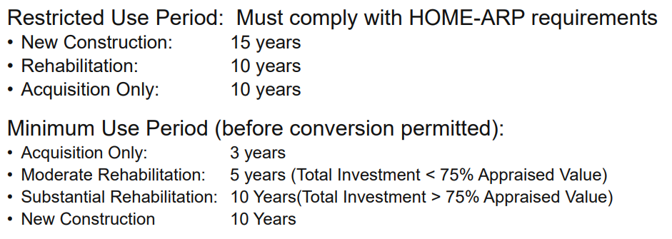
HOME-ARP NON-CONGREGATE SHELTER
RESTRICTED USE PERIOD
After Minimum Use Period Met: units can be converted to HOME-ARP affordable rental housing or to CoC permanent housing.
COST OF CONVERSION CANNOT BE PAID WITH HOME-ARP

Slide 25
HOME-ARP
OTHER FEDERAL REQUIREMENTS
HOME-ARP funds are federal financial assistance and, therefore, are subject to requirements:
Environmental review
  URA Displacement, Relocation, and Acquisition
  Lead-Based Paint
  Nondiscrimination and Equal Opportunity;
  Disclosure Requirements;
  Debarred, Suspended or Ineligible contractors
  Fair Housing
  Drug-free Workplace
  Housing Counseling & Nondiscrimination - NAHA Section 282
  Violence Against Women Act (VAWA) Requirements
  Affirmative Marketing and Minority Business Outreach
  Labor Standards
  Section 3 Economic Opportunities
  Conflicts of Interest

Slide 26
Project Records
Required for all
HOME-ARP Activities
HOME-ARP records must:
Demonstrate each qualifying household is eligible for HOME-ARP assistance
Detail type of HOME-ARP assistance provided
Number of units, families, or qualifying households assisted with HOME-ARP funds
Written policies and procedures for maintaining confidentiality of qualifying households (i.e. domestic violence victims)
Records demonstrating that each household qualifying as homeless meet regulatory “Homeless status”, (24yrs old and under not be required to provide third-party documentation to show they are homeless to receive any shelter, housing, or services for which ESG or CoC Program funds may be used to supplement the HOME-ARP assistance)
Records demonstrating that each household qualifying as “at risk of homelessness,”
Household income evaluation and 2 months of income source documents or third-party written statement

Slide 27
Project Records
HOME-ARP Supportive Services Records (McKinney-Vento or Homelessness Prevention Supportive Services)
  Demonstrate compliance with the termination of assistance: 30-day Notice to Tenant
  Document of solicitations and agreements with contractors
  Procurement documentation and contracts
  Leases, subleases, and financial assistance agreements for the provision of rental payments
  Documentation of payments made by the Subrecipient to owners, or qualifying households for rental payments and supporting documentation for these payments, including dates of occupancy by qualifying individuals and families.
  Document of the monthly allowance for utilities (excluding telephone) in compliance with the rent restriction
  Records of the types of services provided under the PJ’s program and the amounts spent on these services.

Slide 28
Project Records
HOME-ARP TBRA Records
HOME-ARP TBRA units may only be occupied by individuals or families that meet the criteria for one or more of the qualifying populations
Records supporting the rent standard and minimum tenant contribution established
HOME-ARP TBRA units occupied by qualifying household meets the HQS (Housing Quality Standards) at initial occupancy and through term of assistance
Compliance with the tenant protection requirements
Records of emergency transfers requested under 24 CFR 5.2005(e) and 24 CFR 92.359 pertaining to victims of domestic violence

Slide 29
Project Records
HOME-ARP NCS Records
  Records (e.g., inspection reports) demonstrating that each NCS project meets the property and habitability at project completion and throughout restricted use period.
  Records meets the minimum compliance period or restricted use period through deed restriction.
  HOME-ARP NCS projects the following documents must be maintained:
      Purchase contract, closing documents, settlement statement & title review
      Appraisal or other estimation of value to justify acquisition expenditure.
      Architectural and engineering contracts and completed designs, plans, and specifications for rehabilitation and new construction activities.
      Invoices, pay requests, and proof of payment for all project expenditures.
      Proof of insurance.
      Project and program audits.

Slide 30
Record retention
All records pertaining to HOME-ARP funds must be retained for five years
HOME-ARP TBRA projects, records must be retained for five years after the period of rental assistance terminates.
Written agreements must be retained for five years after the agreement terminates.
Records covering displacements and acquisition must be retained for five years after the date by which all persons displaced from the property and all persons whose property is acquired for the project

Slide 31
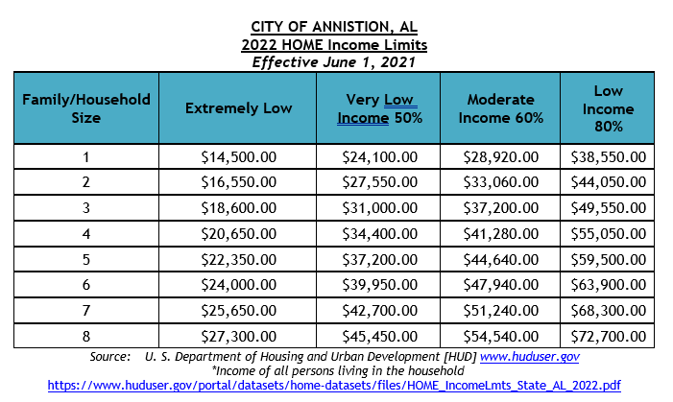
HOME-ARP Income Limits
30% Income Limits are calculated based on the definition of extremely low–income (ELI) family.
HOME-ARP income limit values for large households (9-12 persons) must be rounded to the nearest $50

Slide 32
HOME-ARP rent Limits
HOME-ARP qualified population households rent must meet the following requirements:
Rent may not exceed 30% of the annual income of a family whose income equals 50% of the AMI.
If the unit receives federal or state project-based rental subsidy and the very low-income family pays as a contribution toward rent, not more than 30% of the family's adjusted income, then the maximum rent (i.e., tenant contribution plus project-based rental subsidy) is the rent allowable under the federal or state project-based rental subsidy program.
If a household receives TBRA, the rent is the rent permissible under the applicable rental assistance program (i.e., the tenant rental contribution plus the rental subsidy allowable under that rental assistance program).

