Slide 1
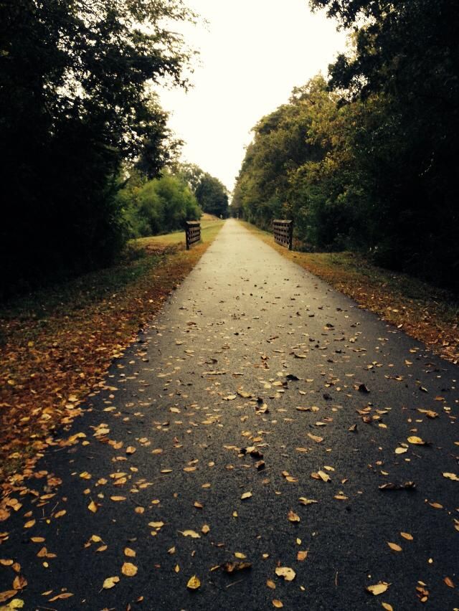
Economic Impact and Benefit of the Recreation Trail Network in Calhoun County
Jennifer green, director
Center for economic development and business research
Jacksonville state university
Chief Ladiga Photo Credit: Jennifer Greenl

Slide 2
“If there’s one essential ingredient to creating trails and trail systems, it’s people. All the land and financing in the world won’t blaze a trail if there aren’t people championing the project.”
- BAY AREA RIDGE TRAIL COUNCIL, In Support of Trails: A Guide to Successful Trail Advocacy, 1993

Slide 3
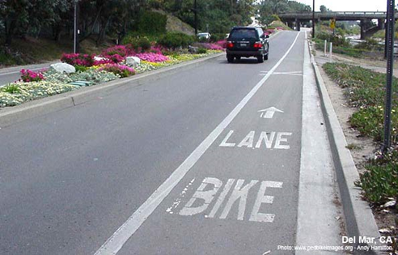
TRAIL PROGRAM BENEFITS
Reduces necessity for auto use
Adds to real estate values and tax revenues
Increases tourism visits, income and jobs
Encourages greater physical activity and health
Increases alternatives for mobility and accessibility
Source: Anniston Area Bicycle Program Integration, 2016 Georgia Trail Summit, April 15, 2016, Carrollton, Georgia

Slide 4
ANNISTON AREA BICYCLE PROGRAM OBJECTIVES
Develop a network of bikeways that:
  Is safe, seamless and complementary
  Utilizes existing and available transportation resources and infrastructures
  Efficiently links important local destinations
  Supports immediate and long-term local development initiatives
  Can be financed and implemented in a phased progression
Source: Anniston Area Bicycle Program Integration, 2016 Georgia Trail Summit, April 15, 2016, Carrollton, Georgia

Slide 5
OVERVIEW
  Chief Ladiga Trail
  Coldwater Mountain Trail
  McClellan Mountain Bike Trail System
  McClellan Multi-Use Trail System (Cane Creek Multi-use Segment and Back Country Horsemen of America)

Slide 6
CHIEF LADIGA TRAIL
The process to complete what will be the final 7.2 miles of the Chief Ladiga Trail is underway. The acquisition phase of the abandoned rail corridor has been initiated. There are several phases of this given that federal dollars are being used for acquisition. This is the only update for acquisition that can be provided until it is completed. The final 7.2 miles, once completed, will establish a 98-mile trail joining the Chief Ladiga Trail and the Silver Comet Trail from Anniston, AL to metropolitan Atlanta. The McClellan Spur, which runs from the abandoned corridor, future Chief Ladiga Trail, is complete. The plans are to connect the trail to McClellan and to points eastward.
Source: Mr. Toby Bennington, Director of Planning and Economic Development, City of Anniston, AL

Slide 7
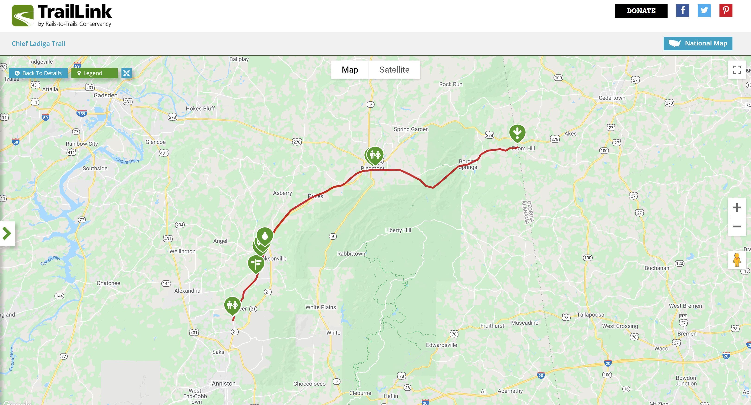
CHIEF LADIGA TRAIL
Source: https://www.traillink.com/trail-maps/chief-ladiga-trail/

Slide 8
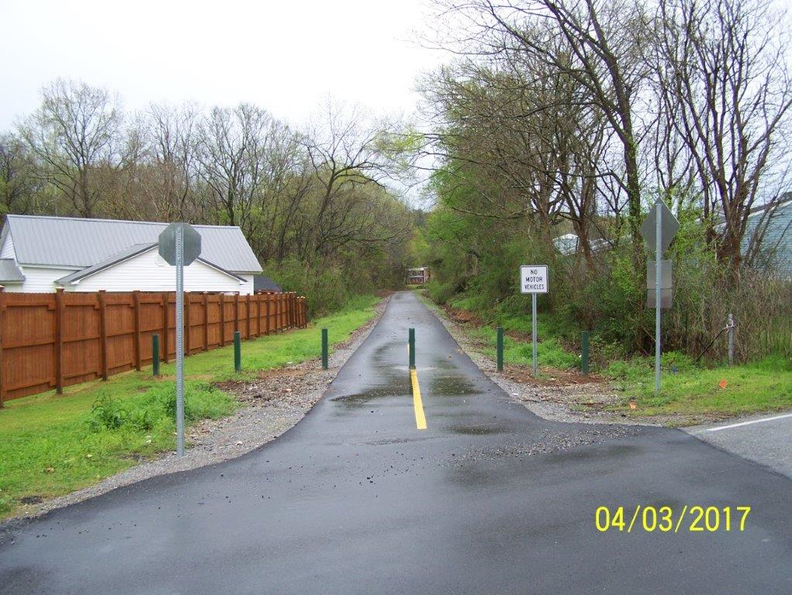
MCCLELLAN SPUR
Source: Mr. Toby Bennington, Director of Planning and Economic Development, City of Anniston, AL

Slide 9
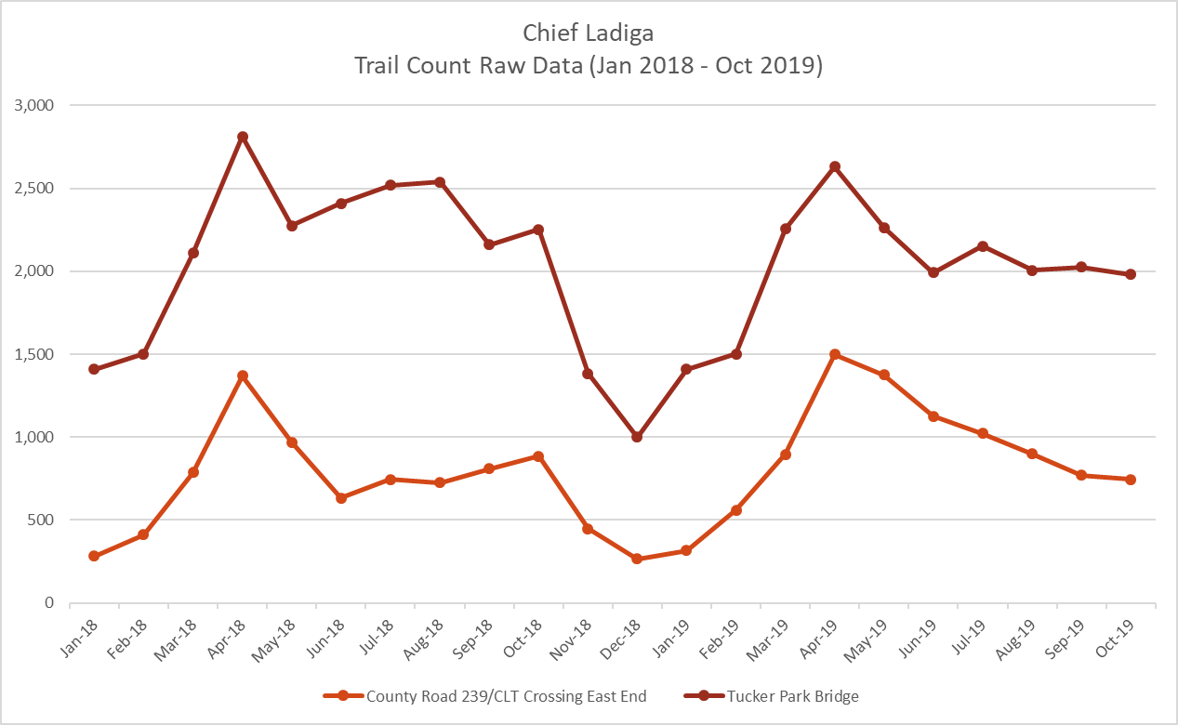
CHIEF LADIGA TRAIL
  TRAIL COUNTS
Source: JSU installed GFX Infrared Trail Countersl

Slide 10
COLDWATER MOUNTAIN TRAILS
  “Coldwater Mountain Bike Trail offers everything a rider could wish for: Explore red-dirt trails in a backcountry setting, shuttle the gravity runs and style out the optional technical lines, or enjoy scenic, entry-level trails that will stoke a novice rider’s fire.”
Source: http://neaba.net/coldwater-mountain.html

Slide 11
COLDWATER MOUNTAIN TRAILS
There are currently two trailheads for the Coldwater Mountain Trail network. One is the original trailhead located at Coldwater Springs, on the western end of the mountain and the other is located off Monsanto Road, both are accessible from Alabama Highway 202. A third trailhead planned will be located on 60 acres of property purchased by the City of Anniston in 2015. It is located on the eastern end in close proximity to downtown Anniston. This trailhead is planned to have amenities such as utilities, pavilions, restrooms, with shower availability and picnic areas. The site will house two parking areas that will have room for recreational vehicles. The city has applied for 1.7 million dollars in funding support from the Economic Development Administration from its Supplementary Disaster Funds. The economic tie to this development is the ecotourism that is connected to Anniston’s, and the region’s economy.
Source: Mr. Toby Bennington, Director of Planning and Economic Development, City of Anniston, AL

Slide 12
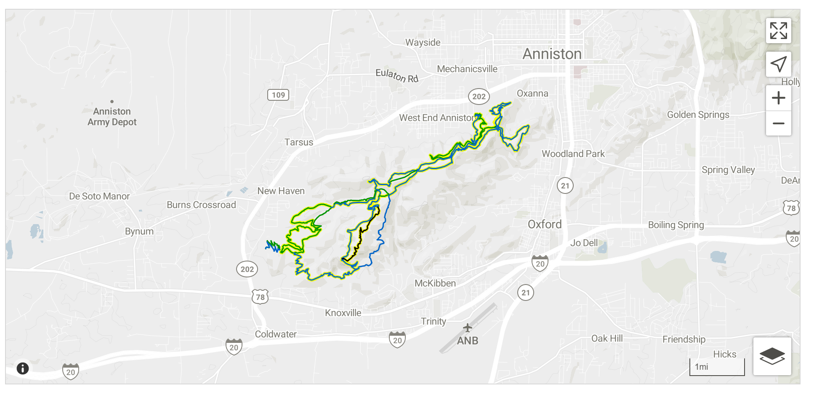
COLDWATER MOUNTAIN TRAILS
Source: https://www.mtbproject.com/directory/8011828/coldwater-mountain

Slide 13
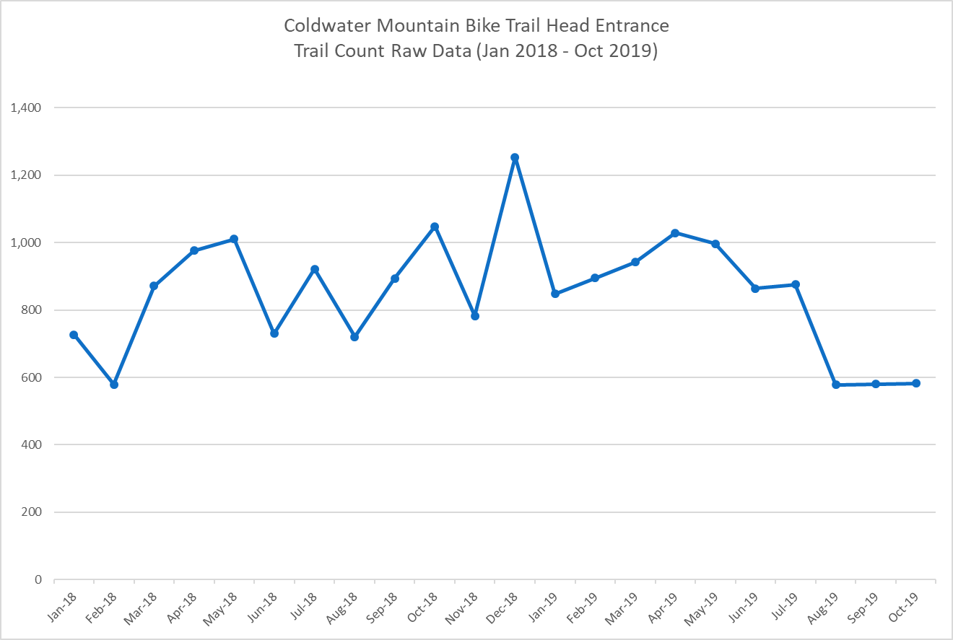
COLDWATER MOUNTAIN TRAILS
  TRAIL COUNTS
Source: JSU installed GFX Infrared Trail Countersl

Slide 14
COLDWATER MOUNTAIN TRAILS
  ECONOMIC IMPACTS
  COLDWATER MOUNTAIN FAT TIRE FEST
  OCTOBER 2019
  113 racers
  Approx 276 attendees
  Average of $232 per day spending
  Average days each attendee stayed in Calhoun County = 2 nights
Source: JSU installed GFX Infrared Trail Countersl

Slide 15
COLDWATER MOUNTAIN TRAILS
  ECONOMIC IMPACTS
  COLDWATER MOUNTAIN FAT TIRE FEST
  OCTOBER 2019
  113 racers
  Approx 276 attendees
  Average of $232 per day spending
  Average days each attendee stayed in Calhoun County = 2 nights
Source: JSU installed GFX Infrared Trail Countersl

Slide 16
COLDWATER MOUNTAIN TRAILS
Total Economic Impact of CWM 2019 Fat Tire Fest on Calhoun County – October 25-27, 2019
Value expressed in 2019 dollar value
  113 racers
  Approx 276 attendees
  Average of $232 per day spending
  Average days each attendee stayed in Calhoun County = 2 nights
Source: IMPLAN Group, LLC. IMPLAN [2018 data year]. Huntersville, NC. IMPLAN.com.

Slide 17
MCCLELLAN BIKE TRAILS
The McClellan Development Authority (MDA) has invested in the planning and development of biking and mountain biking facilities on the former Fort McClellan. The initial and recently developed NICA Course (National Interscholastic Cycling Association) will be one of several for the planned network. The course has already been widely used by groups from around the southeast region and will host its first major competitive event in March of this year. JSU’s Center for Economic Development and Business Research has employed trail counters in order to develop a record of use leading to measuring the economic impact of the course and its activities.
Source: Mr. Toby Bennington, Director of Planning and Economic Development, City of Anniston, AL

Slide 18
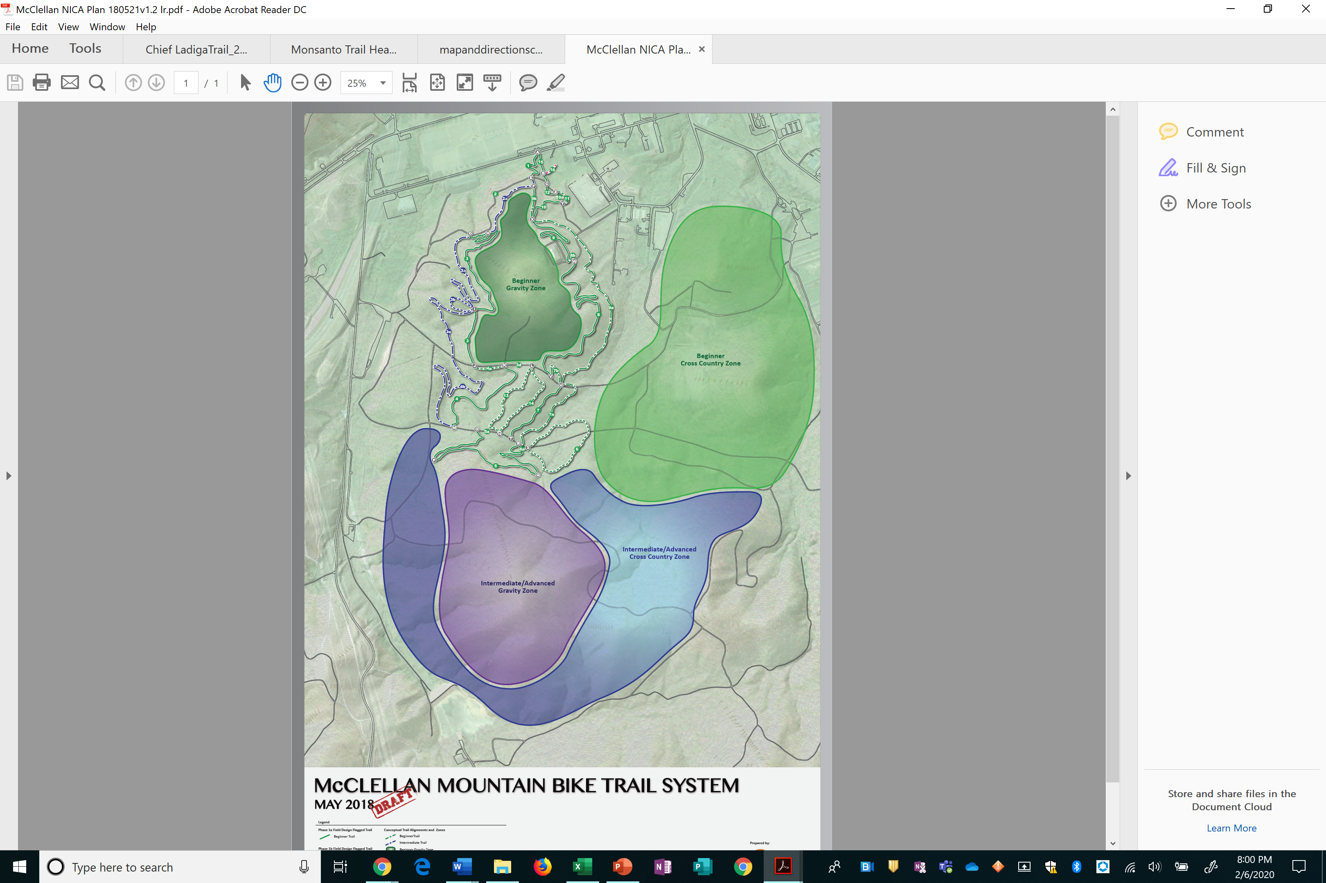
MCCLELLAN BIKE TRAILS
Source: McClellan Development Authority

Slide 19
MCCLELLAN MULTI-USE TRAILS
The primary planned multi use-trail is an extension of the completed Chief Ladiga Trail that will travel east along the McClellan Spur onto McClellan utilizing the existing golf cart path continuing the trail eastward. The plan will define new locations for the golf cart paths as well as a realignment of two of the courses’ tees and greens. The multi-use trail will end with this planning phase at a created trailhead just west of a newly opened South Beach Volleyball facility and venue. This entertainment complex includes a restaurant, professional beach volleyball facilities as well as other game amenities such as corn hole competition spaces. This does open up opportunities for a trail network to extend to neighborhoods at McClellan and extend to the Longleaf Preserve, Talladega National Forest and the Pinhoti Trail.
Source: Mr. Toby Bennington, Director of Planning and Economic Development, City of Anniston, AL

Slide 20
MCCLELLAN EQUESTRIAN TRAILS
Currently planned and under initial construction will be a series of horseback riding trails with amenities for pristine view and enjoyment of horseback riders from all over the country. Easy access as well as an affordable area will make this venue a success. Stay tuned for much more detail on this future treasure.
Source: Mr. Toby Bennington, Director of Planning and Economic Development, City of Anniston, AL

Slide 21
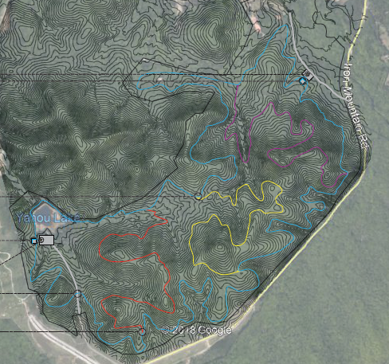

MCCLELLAN MULTI-USE TRAILS
Blue Trail – 12.2 miles
Yellow Trail - 2.7 miles
Purple Trail – 3.0 miles
Red Trail – 2.6 miles
Total – 20.5 miles
Source: BCHA Presentation – July 25 2019 – Meagan Ross, Ian MacPherson

